Slide 1
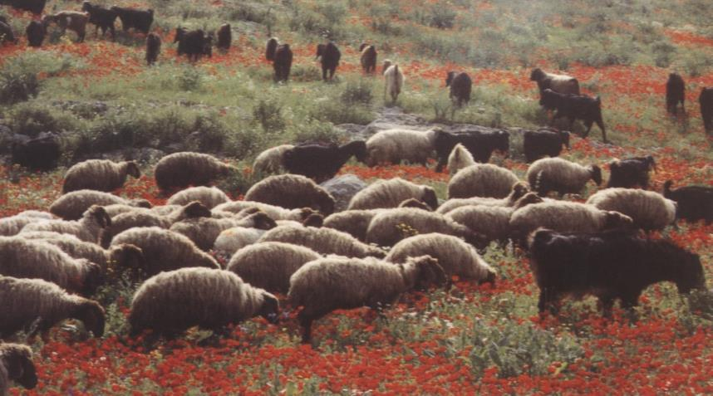
Rural Life
Dr. Rick Griffith • Jordan Evangelical Theological Seminary • BibleStudyDownloads.org

Slide 2
Presentation Outline
What is rural life?
Geography and its effects
Work
Housing
Family Life
Hospitality
Journeys and Travels
Applications

Slide 3
Sheep
Notes:
Sit for three minutes without talking to others and imagine what it would be like to be sitting here all day...
What did you learn from this experience?

Slide 4
What is Rural Life?
158a
Write a definition on page 158a
A Definition of "Rural":
"Happening in or connected with
the countryside, not the city."
(Longman Dictionary of Contemporary English)

Slide 5
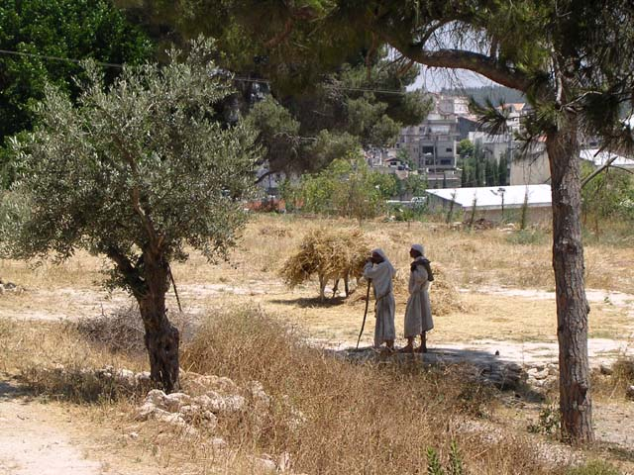
Donkey Loads
Notes:
Let’s sit here for the next 3 minutes and just look at this slide.
Are you going crazy yet?

Slide 6
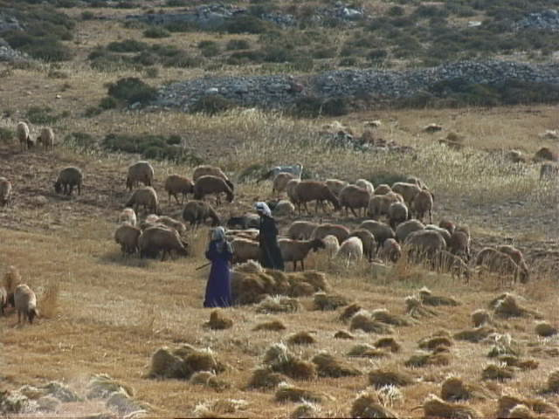
Donkey Loads
Notes:
Let’s sit here for the next 3 minutes and just look at this slide.
Are you now certainly crazy?!

Slide 7
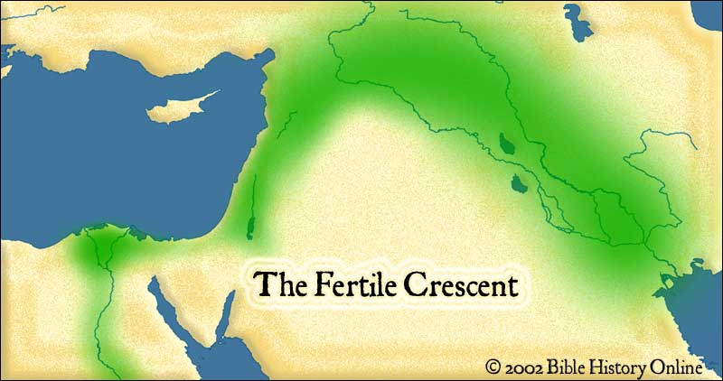
The Fertile Crescent

Slide 8
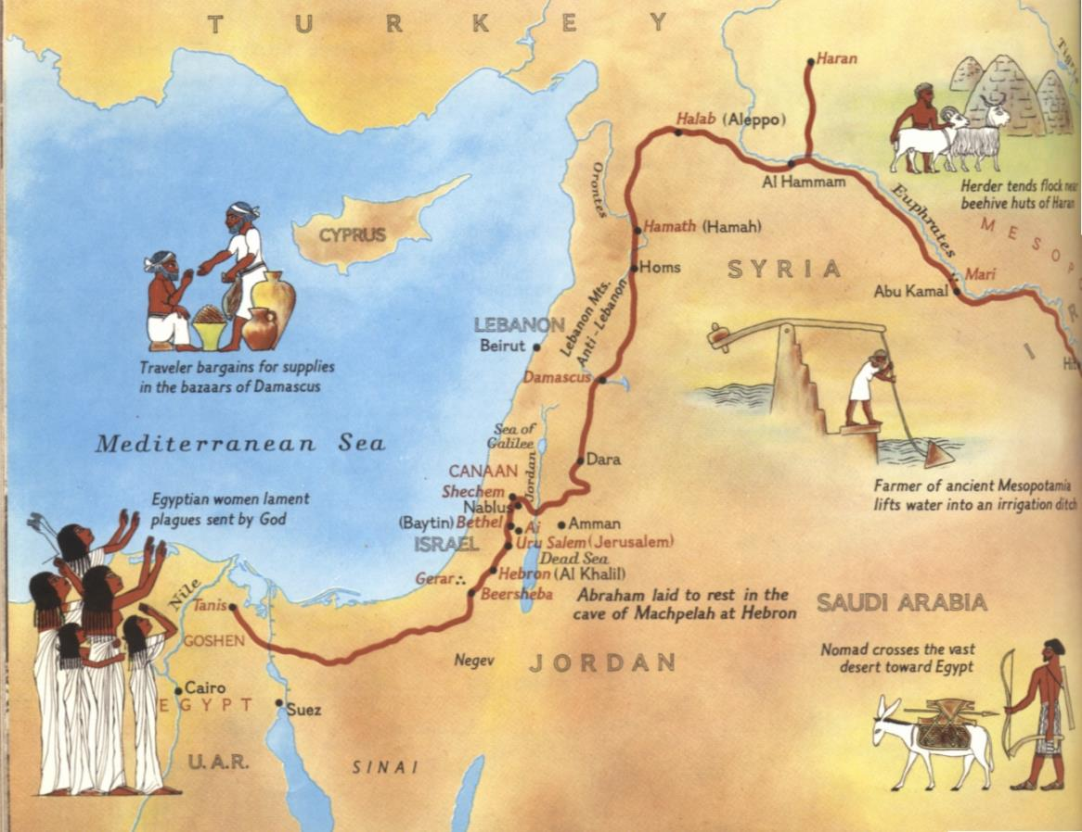
Rural Travel Route

Slide 9
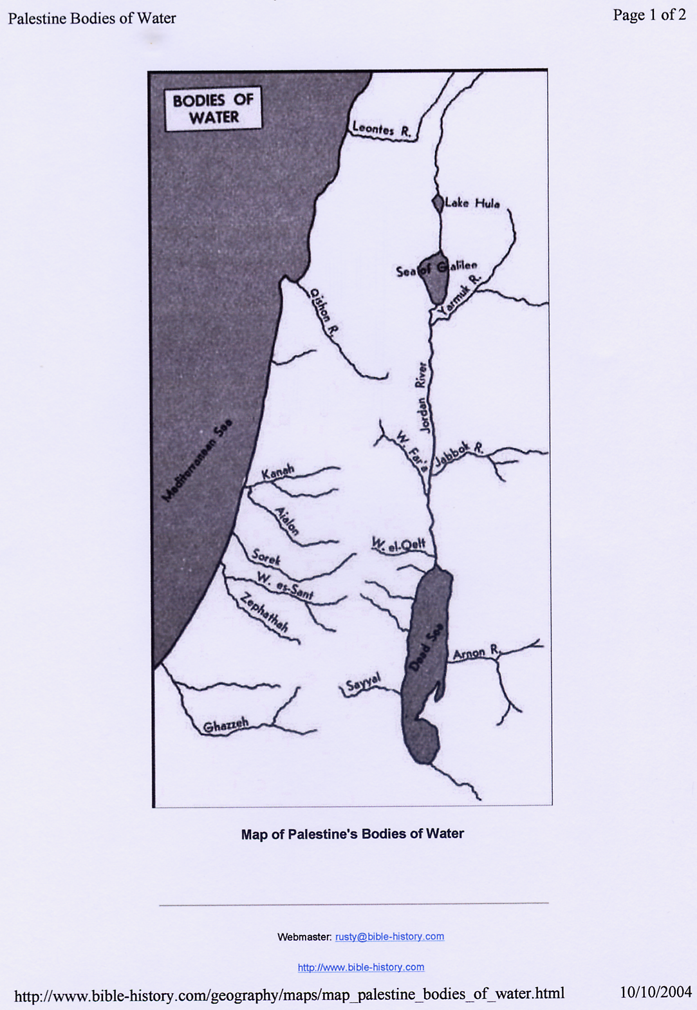
Water Sources in the Land of Canaan

Slide 10
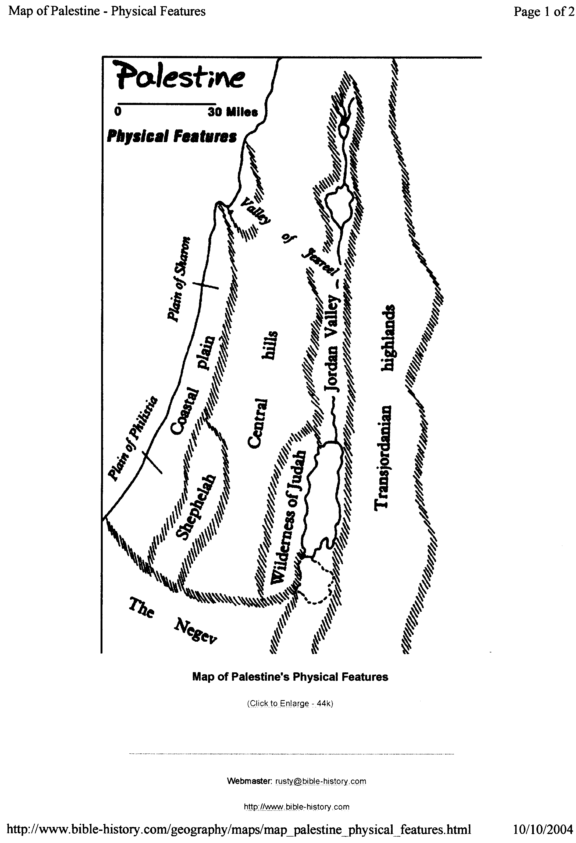
Physical Features of Canaan
20

Slide 11
Seasons
158a
January Coldest month, dark and gloomy with heavy rainfall
February Rainy days and sunny days alternate frequently
March Much more sunshine but very heavy winds
April The greenest month. Many times during this month, dry desert winds blow in for 3 days at a time, melting the snow and quickening the vegetation.
May The heat intensifies and the rain ceases for about 5 months

Slide 12
Seasons
158a
June Barren and parched
July Intense heat cooled by the westerly breeze
August Hottest month of the year
September Summer heat intensified by the desert winds
October Rains begin to fall again
Nov / Dec Heavier rains and cooler weather

Slide 13
Climate
158a
All along the Mediterranean coastline, the lands have a climate which are almost tropical.
Canaan enjoys sunny blue skies from the beginning of May to the end of September with little or no interruption.
The winters are wet and summers hot and dry. Because of these seasonal contrasts in Canaan, snow falls on the mountains and tropical fruits ripen in the plains.
Mount Hermon, which is 40 miles north of the Sea of Galilee, towers 9000 feet above sea level, has white snow caps all year round.

Slide 14
Climate
158a
It rains far more in the mountains then in the plains.
Due to the rift, which is the long straight land trench of the Jordan valley, the city of Jericho receives very little rainfall (about 4 inches annually) while Jerusalem, only 15 miles to the west, has about 20 inches of annual rainfall.
Rainfall in Israel has never been consistent. Sometimes there were very wet winters while other times had famines and drought.
This fluctuation has long taught God's people to depend on Him.

Slide 15
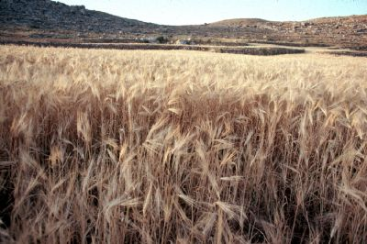
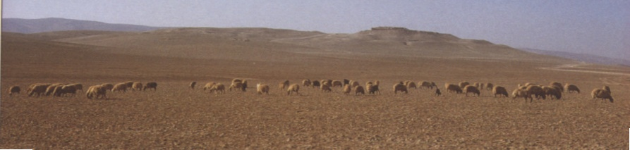
Work
158b
Two main ways to make a living:
  Agriculture
  Shepherding

Slide 16
Agriculture
158c
The Gezer Calendar
The two months are olive harvest | Sep/Oct
The two months are planting grain | Nov/Dec
The two months are late planting | Jan/Feb
The month is hoeing up of flax | Mar
The month is barley harvest | Apr
The month is harvest and festivity | May
The two months are vine tending | Jun/Jul
The month is summer fruit | Au

Slide 17
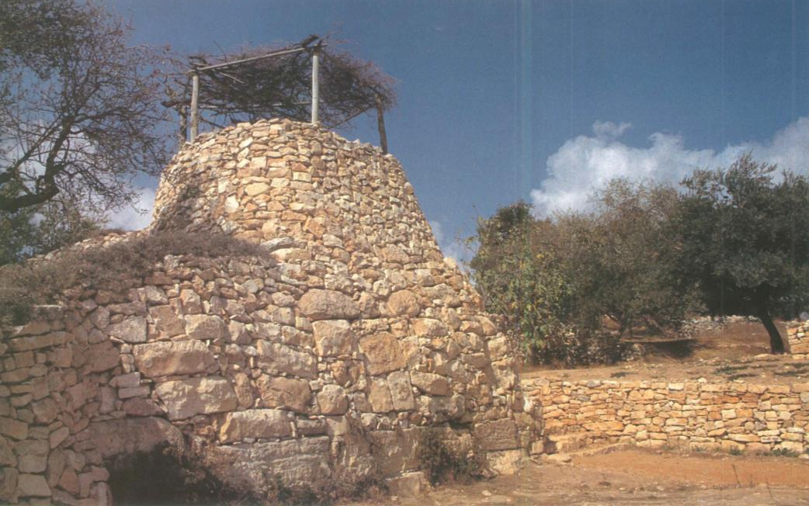
Agriculture
158c
Vineyard Watchtower
Isa. 5:1 NLT “Now I will sing for the one I love, a song about his vineyard:
My beloved had a vineyard on a rich and fertile hill. ²He plowed the land, cleared its stones, and planted it with the best vines. In the middle he built a watchtower and carved a winepress in the nearby rocks. Then he waited for a harvest of sweet grapes, but the grapes that grew were bitter. “

Slide 18
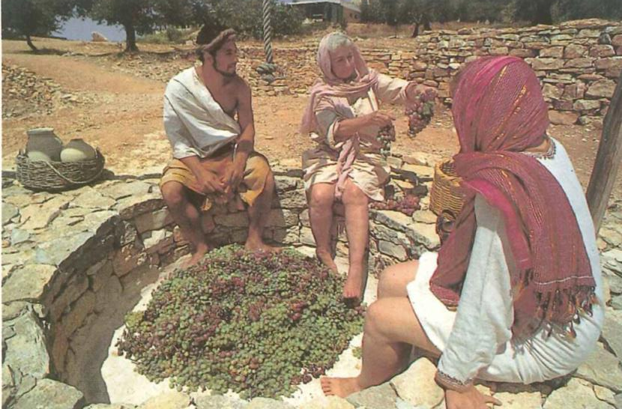
Agriculture
158c
Treading Grapes
Isa. 63:2 NLT “Why are your clothes so red, as if you have been treading out grapes? ³’I have been treading the winepress alone; no one was there to help me. In my anger I have trampled my enemies as if they were grapes. In my fury I have trampled my foes. Their blood has stained my clothes. ⁴For the time has come for me to avenge my people, to ransom them from their oppressors.’”
Notes:
"Three workers sit ready to begin treading freshly harvested grapes in a rock-lined stomping vat" (Calendar from Biblical Resources Scripture Garden, Bethlehem, 1993).

Slide 19
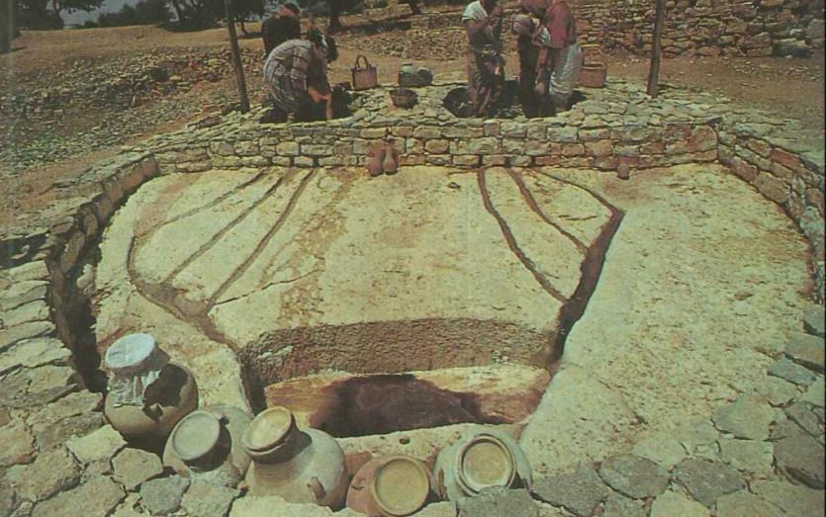
Agriculture
158c
Grape Treading
Joel 3:13 NLT “Swing the sickle, for the harvest is ripe. Come, tread the grapes, for the winepress is full. The storage vats are overflowing with the wickedness of these people.”
Notes:
"Juice from the stomping vat flows through rock-cut channels into a large collection basin. After a few days of initial fermentation, the juice will be strained into storage jars like those visible at the bottom of the photograph. Notice the linen straining cloth over the mouth of a jar to the lower left" (Calendar from Biblical Resources Scripture Garden, Bethlehem, 1993).

Slide 20
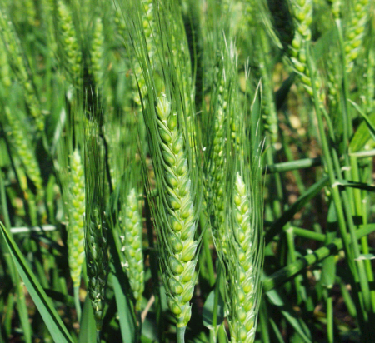
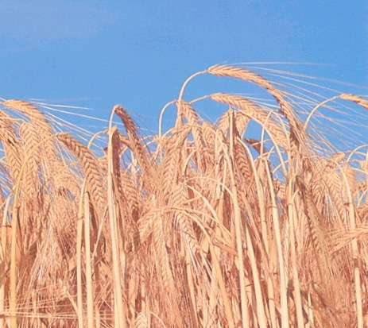
Agriculture
158c
The two most important grain crops:
–Wheat
  Barley

Slide 21
Agriculture
158c
The different agriculture / farming seasons
AUTUMN | WINTER | SPRING | SUMMER
OCT NOV DEC JAN FEB MAR APR MAY JUN JUL AUG SEP
Early Wet Season Latter Summer Dry Season Rains Rains
Ploughing + Planting Growing Reaping (Harvesting)

Slide 22

Harvests Lasted Apr-Nov
183
Harvesting & Ingathering Based on Modern Agricultural Practices in Israel
 | Mar | Apr | May | June | July | Aug | Sep | Oct | Nov
Wheat |  |  | X
Barley |  | X
Oats |  |  | X
Peas |  | X | X
Chickpeas |  |  |  | X
Lentils |  | X | X
Vetch |  | X | X
Sesame |  |  |  |  | X
Flax |  |  |  |  | X
Millet |  |  |  |  | X | X
Grapes |  |  |  | X | X | X | X
Figs |  |  |  |  |  | X | X
Pomegranates |  |  |  |  |  | X | X
Olives |  |  |  |  |  |  | X | X | X
The olive harvest was the final harvest. No wonder why the olive tree represents Israel being restored and fruitful in last days (Jeremiah 11:16; Hosea 14:6; Romans 11:16-21)
http://www.wcg.org/lit/law/festivals/harvest.htm
Notes:
OB-36-Rural Life-32
OS-03-Leviticus-322
OS-04-Numbers-224
Hebrew Roots/The restoration process/Israel
< Hebrew Roots‎ | The restoration process
https://en.wikibooks.org/wiki/Hebrew_Roots/The_restoration_process/Israel
Accessed 23 Feb 2019
THE OLIVE TREE - ISRAEL
The Olive tree is one of the five specie that grow in the land of Israel which are, the Pomegranate, the Fig, the Date Palm, Grape Vines and the Olive (Deut.8:8; Haggai 2:19; Joel 1:12).
By divine decree, the Olive tree has been chosen by Yahweh God as the national emblem of Israel as it characterises their qualities.
The trees grow plentifully around the countryside and are known for their tenacity, as they grow in almost any condition upon the hills or in valleys, in rocky or fertile soil. They are able to thrive in great temperature extremes of cold and heat with a minimum of water, and are virtually indestructible. There are some trees in the land which have survived being destroyed by invading armies, that are over 2,000 years old. Even when cut down or burned, new shoots will emerge from its roots. No matter what the conditions, the evergreen olive tree will live and produce fruit which is a source of food, light, hygiene and healing. Their habit of growth gives them a form of gracefulness and character which sets them apart from other trees.
The first reference in the Bible to the olive is in the Ark. It was an olive leaf that a dove from Noah's ark brought to Noah, “Then the dove came to him in the evening, and behold, a freshly plucked olive leaf was in her mouth; and Noah knew that the waters had receded from the earth” (Gen. 8:11).
From the beginning of civilization, Olives have been eaten as a Mediterranean staple food and olive oil has been used for cooking, in lamps for light (Ex. 27:20, Lev. 24:2), for medicine, and for anointing oil in religious ceremonies (Ex. 30:24-25)
Olive oil was so plentiful in Israel that it was one of the products regularly exported. Solomon sent the King of Tyre 100,000 gallons (378,533 liters) of olive oil (I Kings. 5:11).
It was in the Garden of Gethsemane (Gat Shemen, literally, the place of the “olive press”), where Yeshua spent much of His time in Jerusalem with His disciples. “Coming out, He went to the Mount of Olives, as He was accustomed, and His disciples also followed Him” (Luke 22:39).
The primary characteristics symbolized by the Olive tree is fruitfulness, faithfulness and steadfastness.
Psalms 52:8 says, “But I am like a green olive tree in the house of God; I trust in the mercies of God forever and ever.” By means of His grace, we are sustained by His Presence to remain fruitful, faithful and steadfast.
Psalms 128:3 says, “Your wife shall be like a fruitful vine in the very heart of your house; Your children like olive plants all around your table.” Again, a prophecy of fruitfulness like the olive tree, sending up many shoots from the parent tree to grace their personal altar to the Lord. Coming from their base or root, it symbolizes the blessing of them reproducing their faith and works in their children.
It is in Jeremiah 11:16, that Yahweh identifies the Olive Tree as the symbol of Israel. "The Lord called your name Green Olive Tree, lovely and of good fruit."
Hosea prophesies that in the end-time Israel shall once again be restored and its "branches shall spread; his beauty shall be like an olive tree" (Hosea 14:6)
Paul also in the new covenant uses this same analogy for Israel (Romans 11:16-21).
Rom.11:16 "For if the Firstfruit is holy, the lump also is holy, and if the root is holy, so are the branches. 7 But if some of the branches (of Israel, the Olive tree) were broken off, and you, being a wild olive, were grafted in among them, and became partaker with them of the root of the richness of the olive tree; 18 don't boast over the branches. But if you boast, it is not you who bear the root, but the root you.19 You will say then, "Branches were broken off, that I might be grafted in." 20 True; by their unbelief they were broken off, and you stand by your faith. Don't be conceited, but fear; 21 for if God didn't spare the natural branches, neither will he spare you."
“The State of Israel chose the olive leaves around the Menorah as its emblem. The olive leaves symbolize peace, as this is the wish of our state. The olive also symbolizes light, as the oil produced from the olive lightened the Menorah in the Temple.”
The Olive in the Jewish and Israeli culture - Jerusalem Post
https://www.jpost.com/.../The-Olive-in-the-Jewish-and-Israeli-culture-193416
Oct 31, 2010

Slide 23
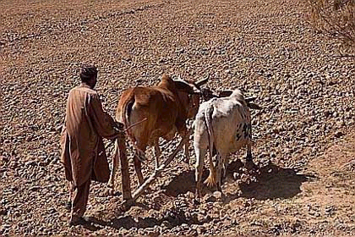
Plowing
158d
Plowing

Slide 24
Plowing
158d
A Possible Parallel:
When the ground is hard, the seed does not go in. When the heart is hard, the Word does not go in. How can I tell if my heart is hard? Before the worship service begins on Sunday morning, what can you do to prepare your heart for God's Word? Before you open your Bible at home, what can you do to prepare your heart for God's Word?

Slide 25
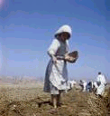
Planting / Sowing
158d
Sowing of Seeds

Slide 26

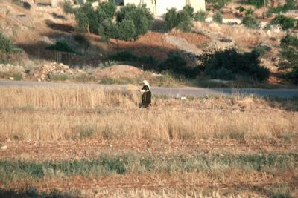

Harvesting / Reaping
158d
Harvesting

Slide 27
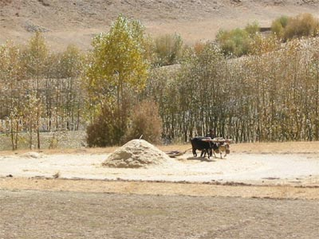
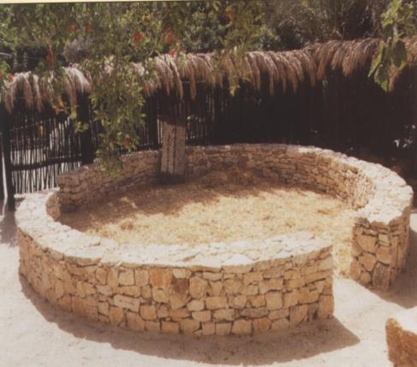
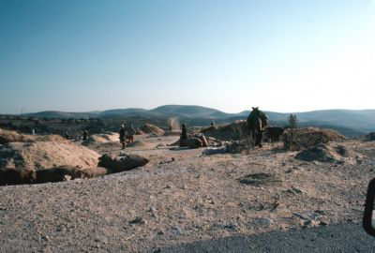
Threshing
158e
Threshing

Slide 28

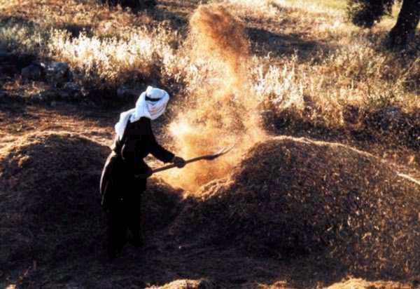
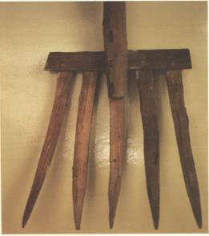
Winnowing
158e
Winnowing

Slide 29
Winnowing
158e
Figurative of the Future:
At Christ's return God will separate people into 2 groups (Matt. 3:12):
The Wheat—good men (those God wants to keep for
Himself)
2. The Chaff—worthless men (those that God must
punish and judge)

Slide 30
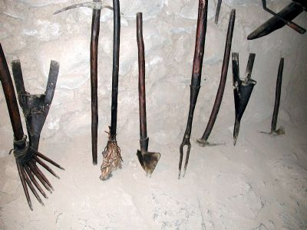
Farming Tools
158e

Slide 31
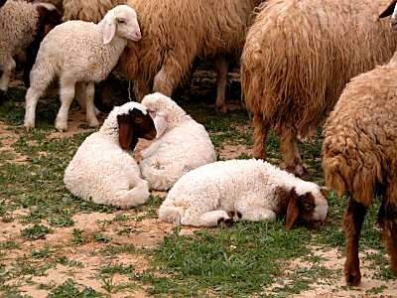
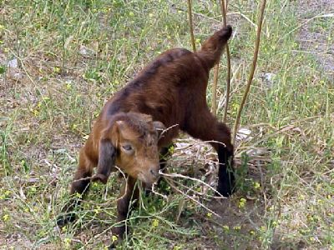
Shepherding
158f
Sheep
Young Goat

Slide 32
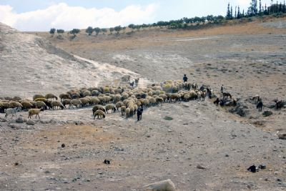
Shepherding
158g
View of a flock of sheep and a few goats in Jordan

Slide 33
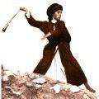
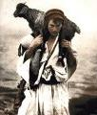
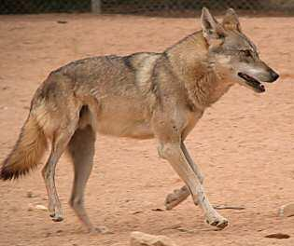
Shepherding
158g
The Good Shepherd
Jackal – One of the dangers to the flock
The Shepherd's Sling

Slide 34
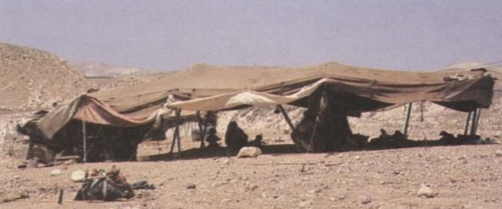
Housing
158g
Ancient nomadic people lived in woven tents

Slide 35
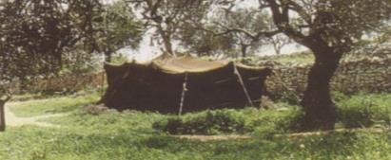
Tent Dwelling
158g
Material is made from black goat's hair
Woven into strips & pieced together by thread
Goat's hair cloth porous when dry but
waterproof after rains have shrunk it

Slide 36
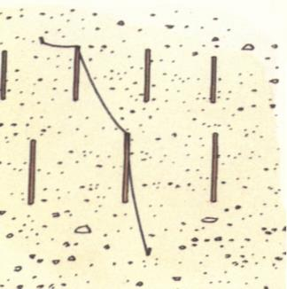
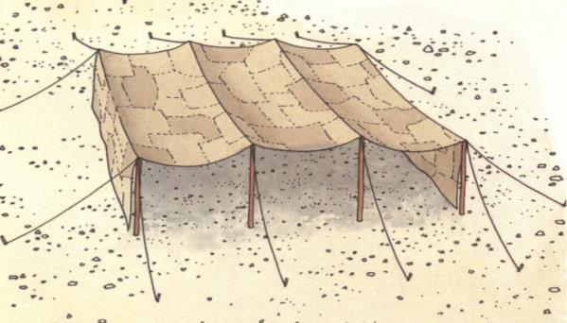
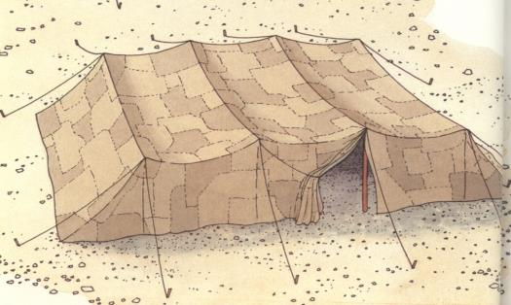
How are tents erected?
158h
Poles are planted and ropes stretched across to hold the canvas.
The two ends of the canvas are pegged to the ground with tent nails.
The two dividing hangings
make an open porch where
visitors can be received.

Slide 37
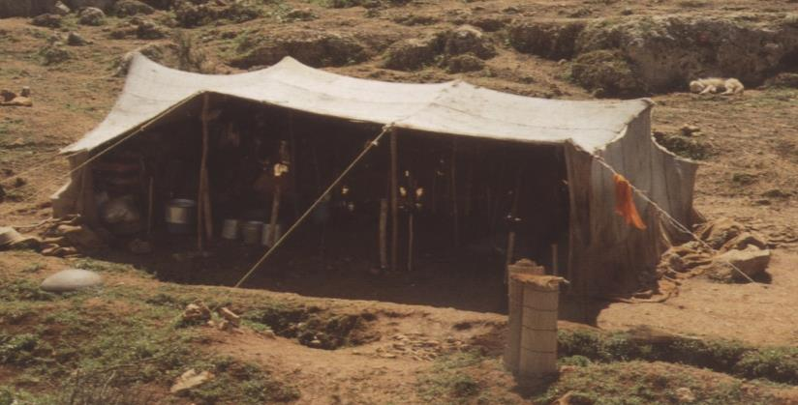
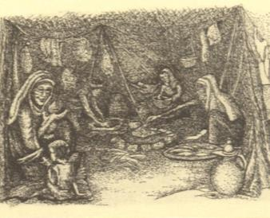
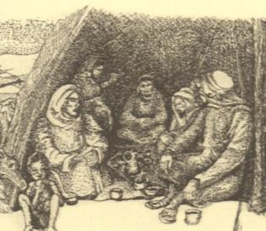
Interior structure
158h
Women's section with
cooking and storage
Men's section for
receiving guests

Slide 38
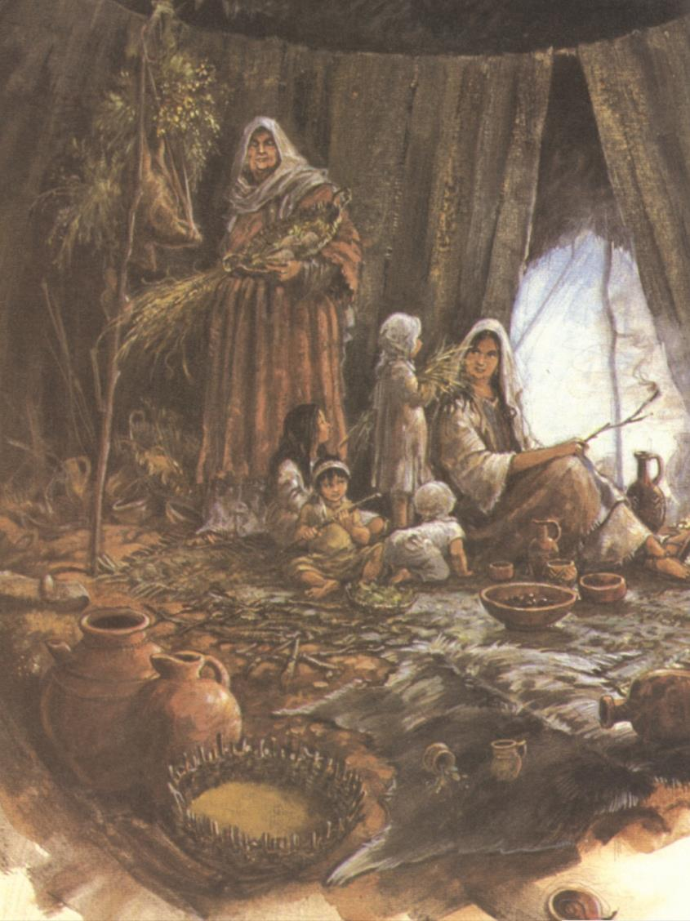
Tent Hearing
158h
The women in the inner area are screened from the view of those in the reception area, but they can hear what goes on in that room
In Genesis 18:10-15, Sarah in the inner area overheard what the angelic guest said in the reception area of Abraham's tent.

Slide 39
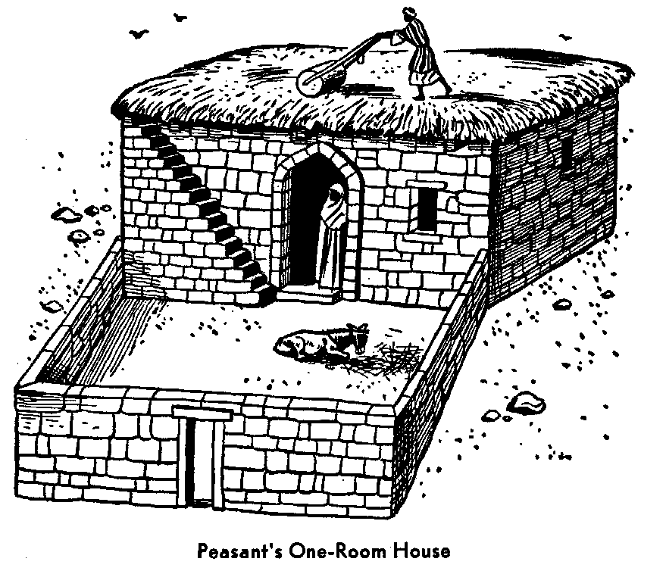
One-Room Dwelling of the Common People
158h
Walls made of sun-dried mud bricks
Construction of the roof:
Laying of beams
Putting on a mat of reefs
Coating clay over it
Scattering sand and pebbles
Using a stone roller to make
it smooth to keep out the rain

Slide 40
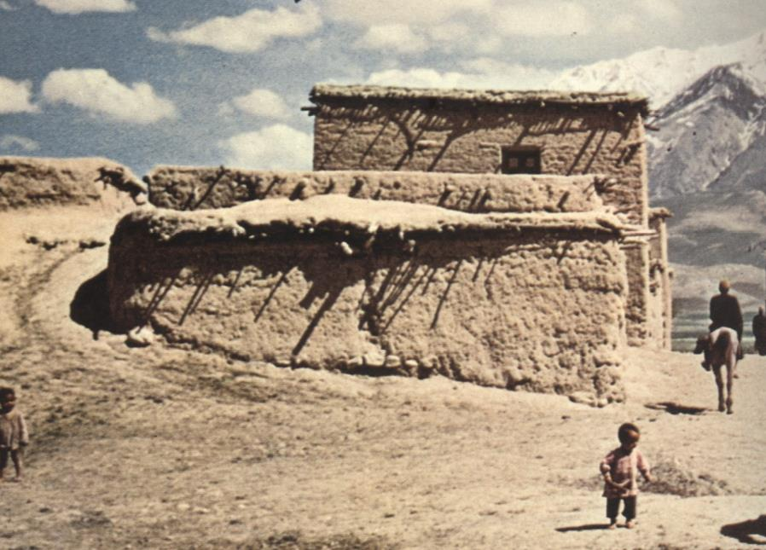
Two Characteristics of the Roof:
158h
1) Leaky roof
A quarrelsome wife is like a constant dripping
on a rainy day.
Proverbs 27:15

Slide 41
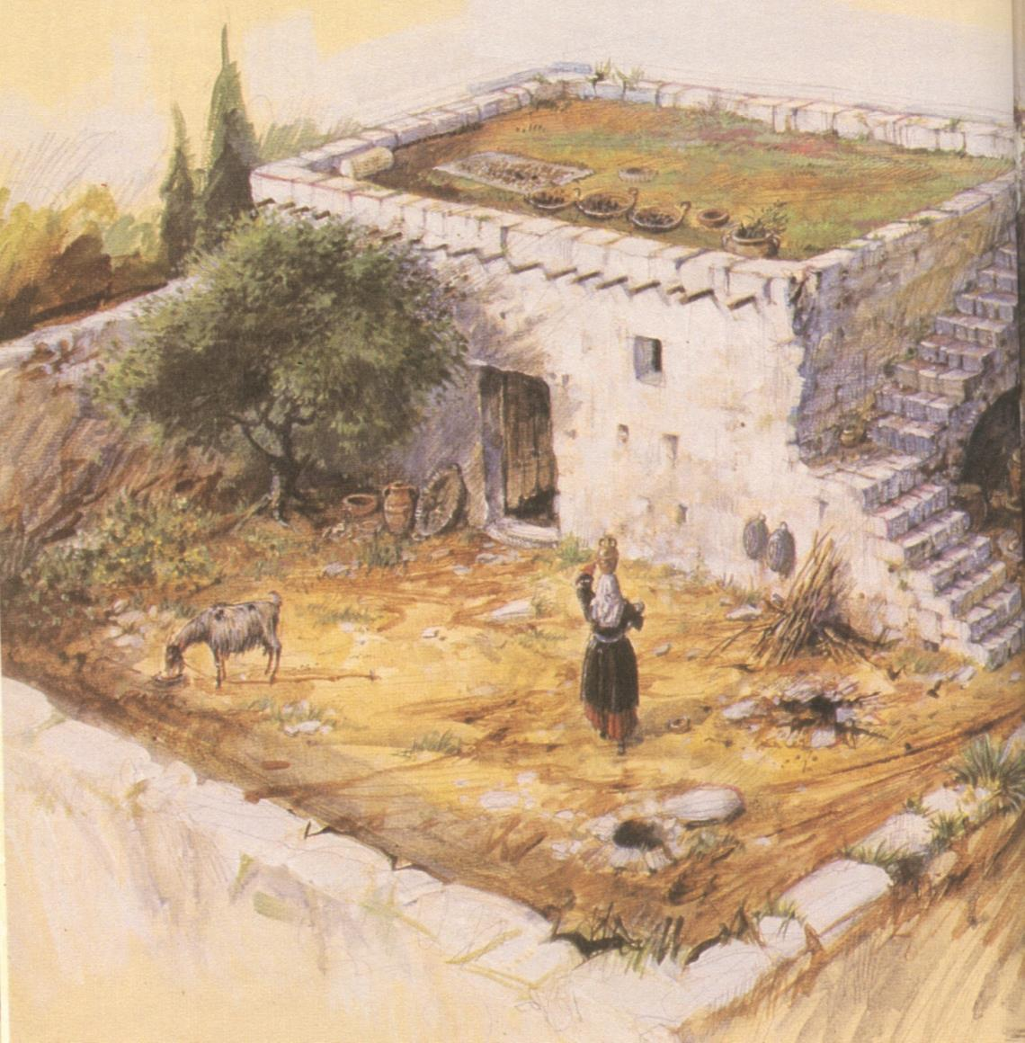
Two Characteristics of the Roof:
158h
2) The roof was green as the seeds in the mud sprouted.
Uses of the roof:
Vantage point
Place for worship
Drying crops
Place for storage
Place to sleep on a hot summer's night

Slide 42
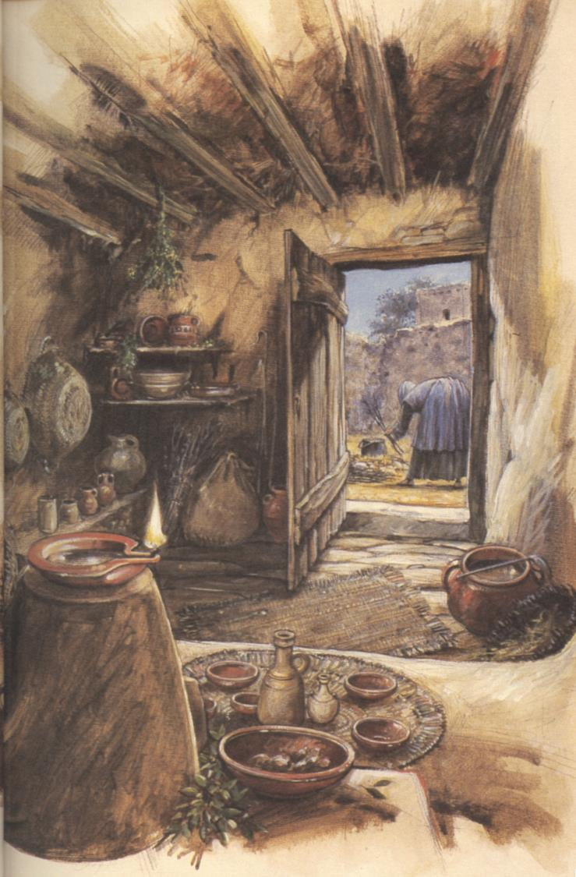
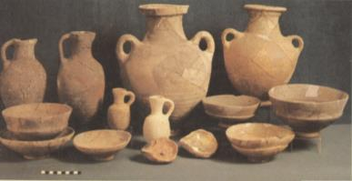

The interior of a peasant's house
158i
Beams
Various jars and pots
for storage
Oil lamp: earthenware saucer
to hold the olive oil and a
pinched lip to hold the wick
Raised platform used for
family activities

Slide 43
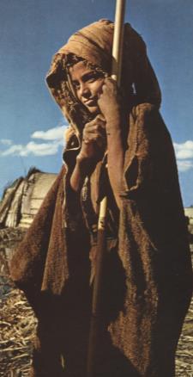
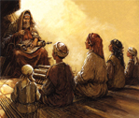
Family Life
158i
Emphasis on large families
Children worked in the home or fields
Father was the head of the household
"Listen, my son, to your father's instruction
And do not forsake your mother's teachings"
(Prov. 1:8)

Slide 44
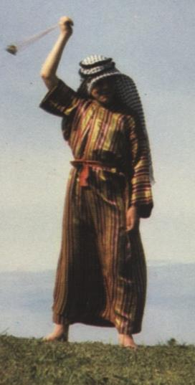
Family Continuity
158i
Authority passed to the eldest son upon the death of the father. Thus Isaac became the new leader over his father's household after Abraham died (Genesis 25).
The Family Shepherd
The youngest boy shepherded the sheep.
Jesse raised his family of eight sons (1 Sam. 16:11) and David, being the youngest, became the family shepherd.

Slide 45
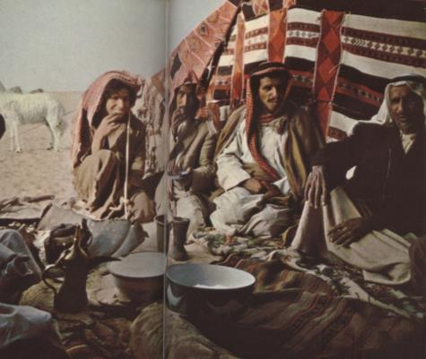
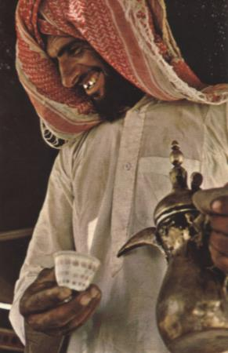
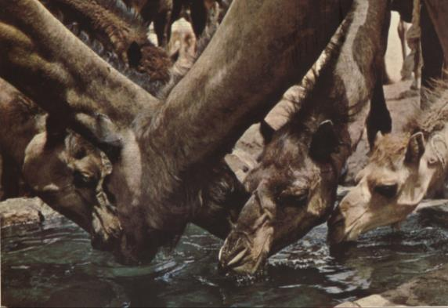
Hospitality
158j
A sacred duty as guests were believed to be sent by God himself
Included:
Food and drink
Protecting guests
Accommodations

Slide 46
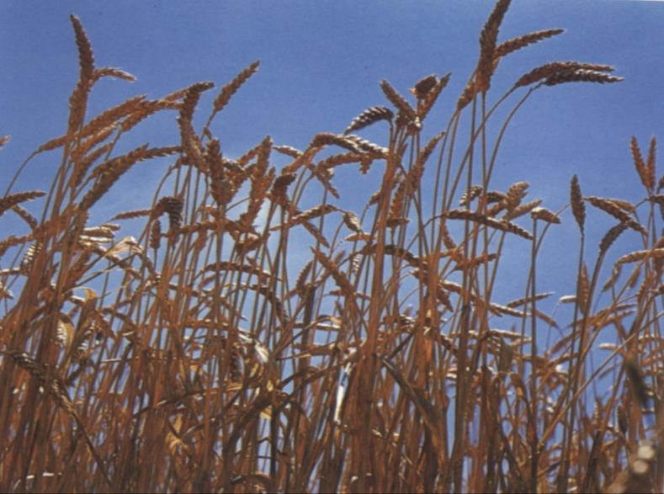

FARMERS' LAW OF HOSPITALITY
158j
Eating grain in the field
Travelers could eat of the wheat as they passed by or through a field, but they could not carry any away with them (Deut. 23:25)
Grain left for the poor
Farmers would never touch the corners of their field when harvesting. It was left for the poor and the stranger
(Lev. 23:22).

Slide 47

Travel
158k
Did people enjoy traveling during the OT times?

Slide 48
Travels (cont'd)
158k
Reasons they did not enjoy traveling:
Bandits
At the mercy of the local people
Limited food
Taxes
Heat
Time taken to greet one another
Need to take care of animals
No 5-star hotels

Slide 49

Modes of travel
158l
THE DONKEY
Basic pack animal
Must be near settlements
First animal used by nomadic people
Can carry people as well as goods
Can pull a plow (Isa. 32:20)

Slide 50
Donkey
158l
Cannot be paired with a larger animal such as an ox (Deut. 22:10)
Can be harnessed to corn mills and to water wheels
Some marked out for royal usage (Judges 5:10)
Replaced by mules as a status symbol
Gradually became a symbol of labour and peace although always the mount of ordinary people (Zech. 9:9; John 12:15)

Slide 51

The Camel

Slide 52

Camel Mug Shot

Slide 53

Camel
158l
Domesticated about 2000 BC
Gave nomadic tribes independence of settlements
Stored enough water for several days (these "desert ships" can travel long distances)
Abraham used camels only for long journeys (Gen. 24:3, 64) as did Jacob (Gen. 31:17)
Important beast of burden--can carry more than a donkey (Camel Load – 2 Kings 8:9)

Slide 54

Camel
158l
Not easy to ride. Humans would travel on donkeys while camels would bear the loads.
Most common type of camel is the single humped camel (Dromedary). It lacks endurance (little fat to store water), but it could travel at nearly 16 km/hr.

Slide 55

Mule
158l
Mules were not used much until David's time because an animal bred from mixed parentage was contrary to the law (Lev. 19:19).
Used as royal mounts (2 Sam. 13:29): When Solomon rode David's mule, it was a sign that he was heir apparent (1 Kings 1:33, 44).
By the time of Isaiah, they were very common (Isa. 66:20).

Slide 56

Horse
Horse
158l
(a) Horses of the Bible were similar to Arabian horses today
(b) Used for war, though not so much as mounted cavalry as to provide a means of pulling chariots (Gen. 41:43, Exod. 14:9)
(c) Also used on a farm (Isa. 28:28)

Slide 57
Horse
Horse
158l
(d) David used horses and chariots but it was Solomon who really developed their usage (1 Kings 4:28; 2 Chron. 1:14; 9:25)
(e) Became a status symbol to have a horse, particularly if one had a chariot to go with it. However, good roads were necessary!
(f) By Roman times, horses became symbols of power (cf. Psalm 147:10)

Slide 58
Applications
158l
Take time to reflect on your life
Depend on God in all things
Be good shepherds

Slide 59
Applications
158k
You reap what you sow
Show hospitality, even to strangers
Keep close ties among your family

Slide 60

Obey the Great Commission!
158k

Slide 61
Sources
158k
- Gower, Ralph. The New Manners and Customs of Bible Times. Chicago: Moody, 1987.
- http://www.biblemagazine.com
- http://www.holylandphotos.org
- http://biblicalstudies.info/transjor.htm
- http://bibleplaces.com/southernwildlife.htm
- http://www.padfield.com/overhead.html

Slide 62
Rural Life
Presented by: Alexander Quong
Tan Mia Huan
Cheam Heng Wee
Ng Wee Hua

Slide 63
Black

Slide 64


OT Backgrounds link at BibleStudyDownloads.org
Get this presentation for free!
Notes:
NT Survey (ns)

